Slide 1
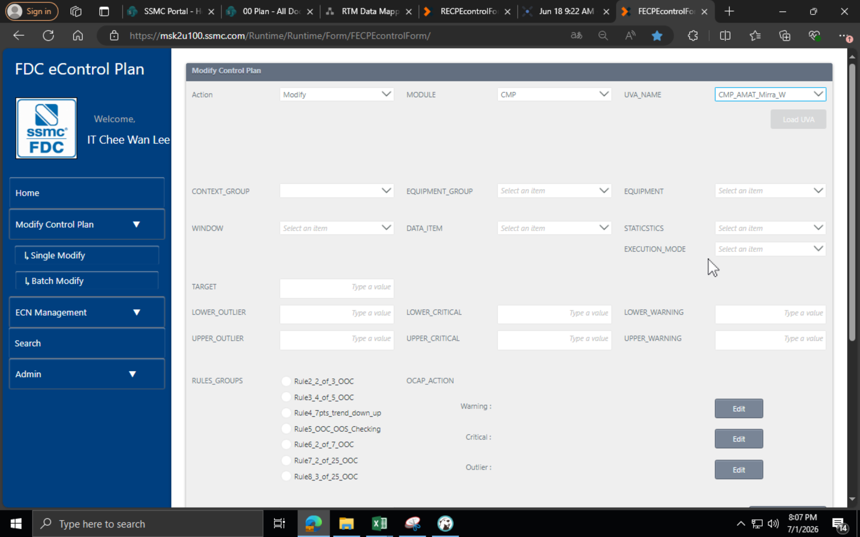
1st load : show freeze chart message
2nd time load different chart but also is freeze no show message
…

Slide 2
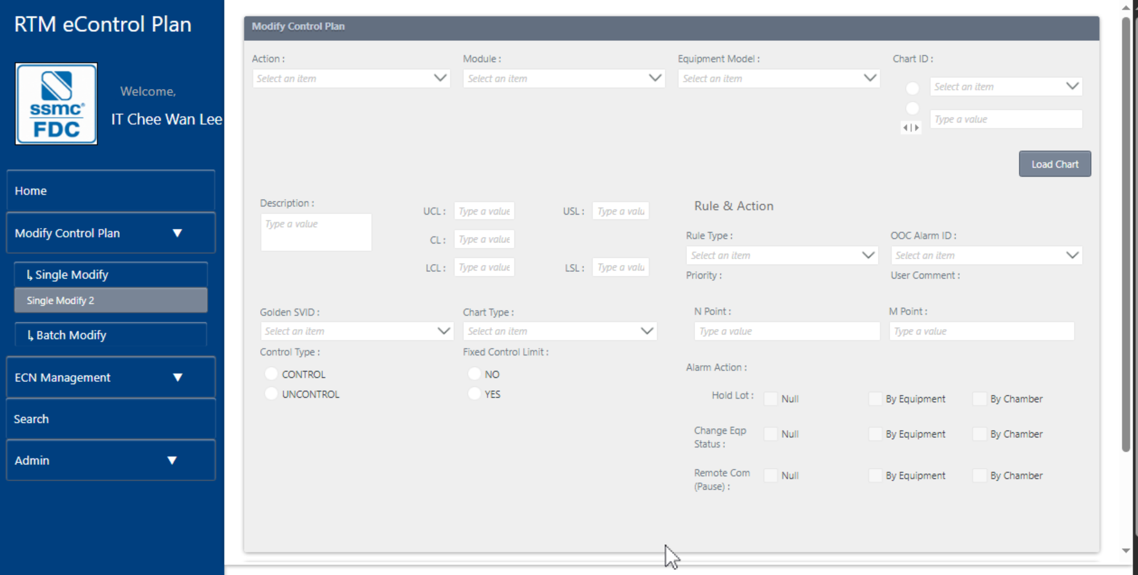
Remove
Move to the Item List view below
Remove

Slide 3
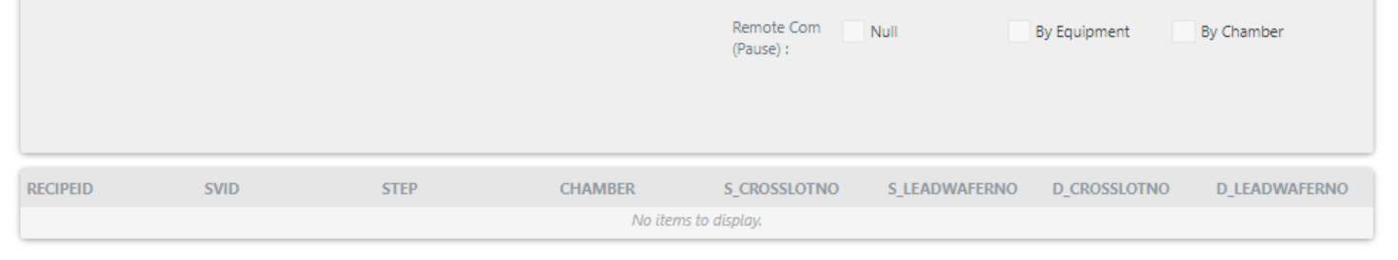
Recipe ID | SVID | STEP | CHAMBER | SLOPE CROSSLOTNO | SLOPE LEADWAFERNO | DIFF CROSSLOTNO | DIFF LEADWAFERNO | SVID GOLDEN | CONTROL TYPE | Chart Type | FIXED CONTROL LIMIT

Slide 4
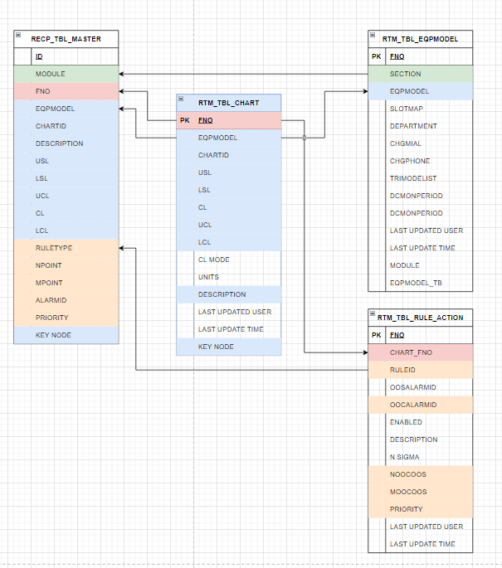
Ecp DB
RTM DB
Need to come proposed flow

Slide 5
Batch Modify – Modify Control Plan
Action | Module | Eqp Model | Chart ID | Description | KeyNode | UCL | CL | LCL | Rule Type | OOC Alarm ID | Alarm Priority | NPoint | MPoint
Draft Pool
ID | EDITING STATUS (Action – No ADD) | MASTERID | REPORTID
Module | Eqp Model | Chart ID | Description | Key | UCL | CL | LCL | Rule Type | NPoint | MPoint | OOC AlarmID | Alarm Priority
CREATEBY | CREATEDATE | LASTUPDATE | DELETEDATE | PROCESSING STATUS
Modify Control Plan – Batch Modify
Golden SVID– Batch Modify

Slide 6
EQPMODEL | CHARTID | RECIPEID | SVID | SVID GOLDEN | CONTROL TYPE | Chart Type | FIXED CONTROL LIMIT
Add new page : modify golden svid
Page – Modify Golden SVID (name to be confirm)
Single Modify
EQPMODEL
CHARTID
RECIPEID
SVID
SVID GOLDEN
CONTROL TYPE
CHART TYPE
FIXED CONTROL LIMIT
Item List – Golden SVID TBL

Slide 7
Page – Modify Golden SVID (name to be confirm)
Add single record
Batch Modify
Item List – Golden SVID TBL
EQPMODEL | CHARTID | RECIPEID | SVID | SVID GOLDEN | CONTROL TYPE | Chart Type | FIXED CONTROL LIMIT
DPS | Chart-1 | R-1 | S-1 | A | A | B | B
DPS | Chart-1 | R-2 | S-1 | C | D | E | F

Slide 8
Page – Modify Golden SVID (name to be confirm)
Add single record
Batch Modify
Export Excel
Item List – Golden SVID TBL
EQPMODEL | CHARTID | RECIPEID | SVID | SVID GOLDEN | CONTROL TYPE | Chart Type | FIXED CONTROL LIMIT
DPS | Chart-1 | R-1 | S-1 | A | A | B | B
DPS | Chart-1 | R-2 | S-1 | C | D | E | F
Golden SVID

Slide 9
Ref
EQP Model
Chart ID
Recipe
SVID
Golden SVID
DD
Control / Uncontrol
Input
Chart Type ( 1 – 6 )
Fixed Control Limit (Y/N)

Slide 10
Batch Modify – Golden SVID Control
EQPMODEL | CHARTID | RECIPEID | SVID | SVID GOLDEN | CONTROL TYPE | Chart Type | FIXED CONTROL LIMIT
Batch Modify – Golden SVID Control
FNO | EQPMODEL | CHARTID | RECIPEID | SVID | SVID GOLDEN | CONTROL TYPE | Chart Type | FIXED CONTROL LIMIT
LASTUPDATE USER | LASTUPDATE TIME | DELETEDATE

Slide 12


